Slide 1
Part II
Why? Or how did we get here?

Slide 2



Erlang was created 30 years ago
Reliability
Reliable code is simple code
Distributed systems are complex – build with simple parts
Even with simple code, shit can happen – isolation and recovery
There’s more to reliability than writing correct programs – shit happens
<LINK TO RELIABLE PROGRAMMING>
zHow to make a reliable system
Prolog
Reliable programming
The most reliable systems in the world run Erlang
Notes:
Elixir is Erlang (so what’s new?)
-> next top: This brings to next topic
Simple building blocks
There’s more to reliability than writing correct programs

Slide 3

Erlang
In 2010 Erlang was known as the best C10K solution and behind some of the most reliable systems in the world.
What’sApp setting new records
Erlang syntax was difficult – too low level, verbose.
Used in specialized applications – very academic
Great network capabilities, but not much in the web of modern web interfaces
Tool chain not exciting
Solidly built and fully Open Source
Incredibly cool Macro system that let’s you do just about anything
Notes:
I’m included in this group
There are many languages built on top of the Erlang VM
You don’t get OO, but you still need code reuse
Periods end statements don’t they

Slide 4



Erlang is Very Open Source
https://en.wikipedia.org/wiki/Erlang_(programming_language)
By 1988 Erlang had proven that it was suitable for prototyping telephone exchanges…
In 1998, C++ and OO patterns was going to save the world and make us all super-human programmers (coders)
In 1998 Ericsson announced the AXD301 switch, containing over a million lines of Erlang and reported to achieve a high availability of nine "9"s.^{[11]} Shortly thereafter, Ericsson Radio Systems banned the in-house use of Erlang for new products, citing a preference for non-proprietary languages.
Java was touted as a safer way to do OO. C++ people hated it and said it would never perform
The implementation was open-sourced at the end of the year.^{[6]} Ericsson eventually lifted the ban and re-hired Armstrong in 2004.^{[12]}
And So Elixir is very Open Source Also
Notes:
What do C++ and Erlang have in common?

Slide 5

A bunch of Rails guys
Wanted to
scale network connections (ActionCable team members)
reliable way
and still be part of an application
They liked
Clojure and functional programming
Linq
The Erlang Way (more later)

Slide 6
Erlang to the people: Elixir
Build a new syntax*
Twist a few rules – names can be reused*
Add a modern package manager (like Gem)
Implement standard libraries very similar to Clojure: Map, Enum.filter
Phoenix (offshoot): A Web Framework - Ecto borrows on Microsoft Linq
Leverage everything in Erlang – 100% interop with Erlang all the time
Notes:
The AST is very very easy
Erlang people hate this
Cowboy is great Erlang’s incredible safe Macros allows Erlang syntax to be changed (AST). Elixir is just and extension and unlike Clojure which introduces new data structures, etc.

Slide 7

Safety
highly reliable fault-tolerant systems
NEED CODE EXAMPLES
A
B
https://cacm.acm.org/magazines/2010/9/98014-erlang/fulltext

Slide 8
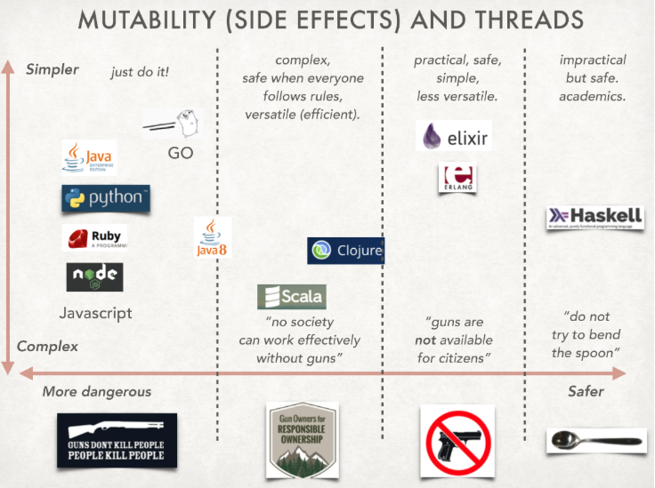
https://tomjoro.github.io/2017-01-31-world-changed/
Safety categorization chart (memory models)

Slide 9


Java
How is a thread different from a process?
Thread #1
Thread #2
init ()
While (1);
How to kill thread 1 because it is misbehaving?
What if a library creates a lot of threads?
Thread 1 objects Thread 2 objects
What happens during Garbage Collection?
Our shared memory

Slide 10




Elixir Supervisor
Just another process “with one job”
Process2
Process 1
My
What happens during Garbage Collection?
Wait, some asks “how can you say they are physically separate? Don’t they run on the same machine/memory?”
Yes, (you can run out) but there are no guns – there are no mechanisms to even refer to some other memory
Notes:
Actually: Erlang believes the same thing “Let it crash” But
Do you best to make sure it never happens
Minimize damage by using isolation
If it does happen have a plan of action:
Plan who is watching whom
What other services need to be restarted, etc.
How many times do I try to restart, etc.
Accurate logging

Slide 11


But I don’t need that kind of reliability in my program - it’s just a stupid webapp, and if I did need it I could just start lots of node.js instances and so if one failed that’s fine
My code doesn’t crash
I’m careful

Slide 12

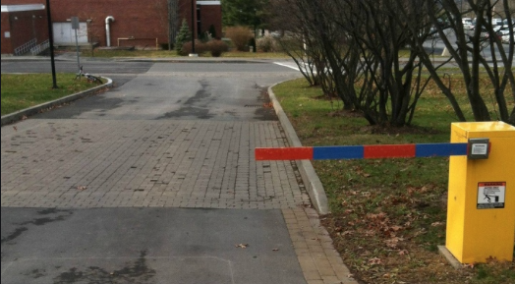

You had one job…
A program that has errors not only can crash, it can leak data, have security problem and if it multithreaded it can put the entire system in to an uncertain state. Libraries and other peoples code may affect your code.
Notes:
*Btw our FP server has never gone down.

Slide 13
Practical

Slide 14
Reliability in the physical world
The system would have to be constructed from physically isolated components communicating through well-defined "pure" protocols.
The physical world in 1986
Notes:
That’s why Java didn’t support multiple cores for a long time.
Of course you can run many processes on each core, but they will not be parallel

Slide 15
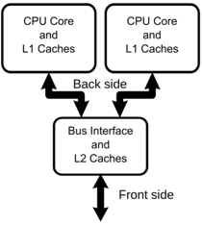


Multicore
Sharing memory results in cache miss and stalled pipeline
Local small memory that is per process is the most efficient way to run in a multi core system
(and that’s also why the GC is so efficient on Erlang)
Notes:
So is copying inefficient – you’re doing it anyways
Local small memory that is per process is the most efficient way to run in a multi core system

Slide 16


If it works for physical world….
Erlang: Let’s build lots of little virtual CPUs (processes) on a single computer:
But they must behave the same as if they were physically separated
That also means that if I want, I can put the process on another computer without any changes
So interprocess or over network is the same as local interprocess
Solve your problems using sequences of statements, and don’t worry about the cores/threads
Elixir is future proof: it get’s better and better all the time!

Slide 17
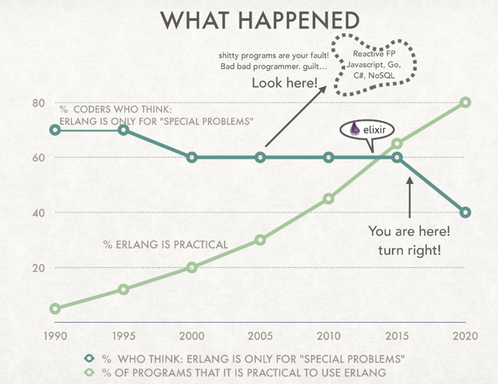
Practical – the world changed
Read my blog: https://tomjoro.github.io/2017-01-31-world-changed/
Shitty programs are the result of bad coders… True/false?
”The principal objection was efficiency; copying messages between processes (instead of using shared memory) was considered horrendously inefficient. ”

Slide 18
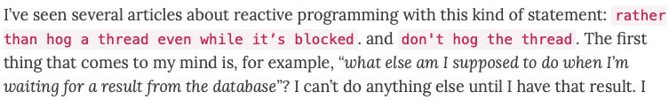
https://tomjoro.github.io/2017-02-03-why-reactive-fp-sucks/
Don’t Hog The Thread
It’s my thread, and I’ll do what I want with it!
Libraries? What if they do threading? How do we get along?

Slide 19
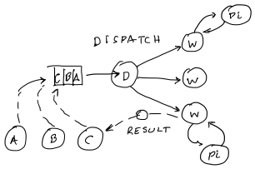
Problem
Requests arrive from clients one after another and are queued
D accept’s on and dispatch to worker
Process as fast as possible, concurrently or parallel (B doesn’t have to wait for A)
Occasionally one of them does a big calculation

Slide 20
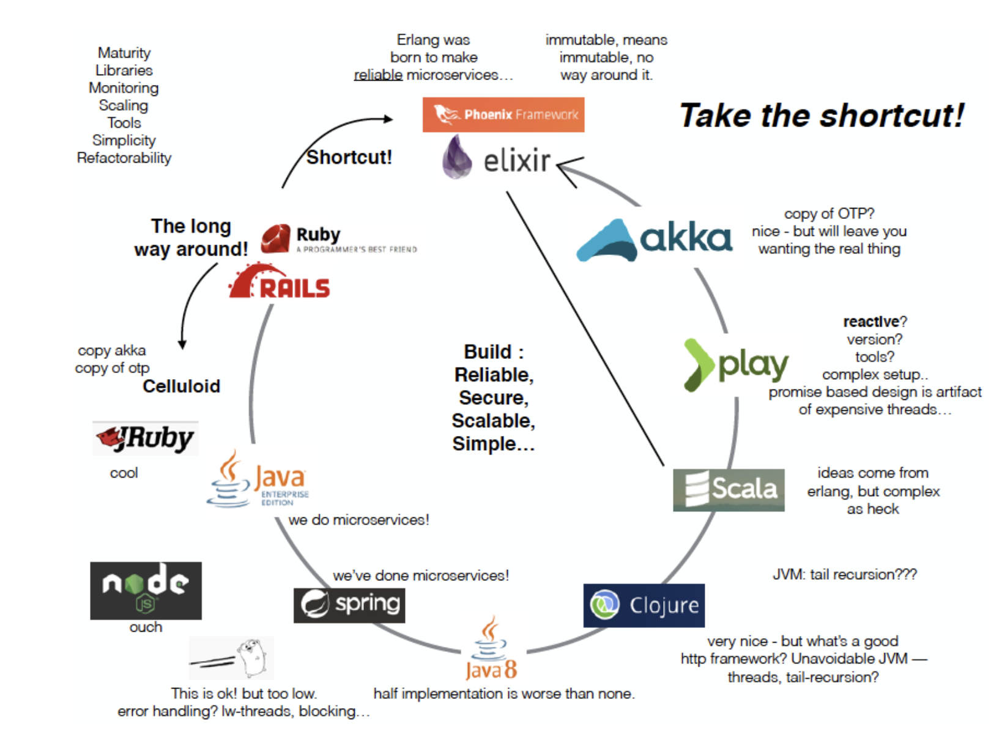

Slide 21
My favorite Go routines
While(1);
Link to issue…
My favorite java clojure implementation

Slide 22
People asked
What about clojure – look at pmap reduce code, tail recursion, web framework?
What about go, show me an example where it crashes
Bash more
What is a fair scheduler
Lambdas
Functions != processes
Startup times, strategies, state.
Future is stateful – why are we in this stateless world?
Put data, not internal state just because you are stateless

Slide 23
Ways to solve
DO A
DO B
START C
DO D
WAIT_FOR C
DO E
Threads (or Processes)
Blocking threads, just lots of them (blocking on what)
A thread pool and handover, etc.
Asynchronous I/O
Non-blocking I/O, share a thread and give it up cooperatively

Slide 24
Some examples
Scala/Play and Akka, etc.
Mixes Asynchronous I/O and Threads
Strange results
If you happen to be running on the same thread that starts doing some big operation and stalls the thread
Rails
Take your pick:
non-blocking (Thin),
Threads (Puma),
Forked processes (Unicorn)

Slide 25
I want:
A threaded/process type solution,
but with the isolation of processes, but
Without the heaviness
And I still want to talk to the other processes when needed
Lightweight isolated processes – as many as you want!

Slide 26
It can’t be all roses

Slide 27
What is Elixir not Good For
Image processing
Game engines (some)
High performance compute engines
In order to ensure safety, Elixir does not have indexed data structures so (very efficient) binary trees are the data structures

Slide 28
Unsafe parts of applications != don’t use Elixir
Elixir is great at interfacing and controlling
There are lots of techniques: ETS, for example
Just because 5% of your program is something that <drawing> is unsafe, doesn’t mean you can’t use Elixir
REST
Ports
Compiled in binary
Rust is a good way to do it because it is guaranteed not to leak. But be careful about threading (it needs it’s own thread).

Slide 29
Can we get back to coding please?
In a minute

Slide 30
I love it, but It can’t possibly work
Immutability – is it really going to create a new object every time? Garbage must pile up like crazy….
Overhead of copying even when I’m calling to processes on the same core?
Can I really create 10,000 process? And they schedule fairly?
Can I solve everything with Tuples, Maps, and Lists? And Recursion!
Can I live without Object Orientation? There are macros in Elixir… wtf?
I’m not convinced “Let it crash” is good… shouldn’t I handle the errors when they happen?
Notes:
It solves my problems

Slide 31
Code – try it yourself
https://github.com/tomjoro/elixir_safe_practical/code/part2
Parallel Map Reduce in Elixir
Lots of processes
Ruby vs Elixir Parser
Parsing and performance comparisons – garbage collection
Go vs Elixir for 2d
Worst case for Elixir, Good case for Go
Notes:
How do you kill a Java thread? Is it safe to do such a think? Impossible?

Slide 32















Guaranteed
isolated
Multicore pre-emptive
(soft real-time)
Per-process Garbage
Simple – no OO
Not
dynamic
”Memory safe” + checked
Pre-emptive
scheduler
Virtual machine
Stop the world
Garbage
Complex –
OO + Functional
Lightweight/
Green threads
Dynamic
No-virtual machine
”Memory safe”
But threads can share memory
Clean up
yourself
Cooperative scheduling
Memory not checked
Notes:
Name that language Game! Prizes!
It’s not fair, because the garbage collector can run and you will get stopped.
What is Elixir good for. What is it not good for? Do I need a slide?
GO Does not have a virtual machine. It compiles bare.

Slide 33
Part 3
Phoenix and Phoenix Live View

Slide 34
Phoenix
”I’m looking at some Phoenix code. I don’t see any processes or spawning or any of that stuff. Is it really there?”
Yes:
Cowboy is create a new process for every web request that is received
Ecto uses Poolboy and a pool of process to talk to external resources
There are hundreds of processes running out of the box in Phoenix
You just normally are using a much higher abstraction.. ☺ called OTP…. Which is another topic

Slide 35
Practical Elixir
How do I debug?
It’s difficult because it is inherently asynchronous and concurrent
IO.puts
Iex.break
Test cases are great
Trace
:monitor

Slide 36
Code example
In the sample code there is “talented_live” which has 3 parts:
talented_live1 – setup
talented_live2 – adding live view
talented_live3 – doing something with live view
https://github.com/tomjoro/elixir_safe_practical/code/part3

